Slide 1

The Query Ran Successfully.
That’s the Problem.
How security engineers have to think differently about KQL, telemetry, detection logic, and AI-generated analysis
Ian Hanley • KQL Café
Notes:
Last time I came on KQL Café, I showed you KQL I was proud of.
So naturally, this time I brought KQL that's wrong.
And the annoying part is that most of it runs perfectly.
No syntax errors, No red squiggles, No complaints from Kusto… It returns exactly what I asked for.
And that's the problem.
Because over the last few months I've been doing something slightly ridiculous.

Slide 2

WHY THIS TOPIC NOW
03
I built a machine that writes detections
That made human review more important — not less.
THREAT INTEL
BEHAVIORS
HYPOTHESES
KQL CANDIDATES
HUMAN REVIEW
~30 detection candidates / week
Scale is useful. Scale also multiplies whatever mistakes survive your controls.
Notes:
Explain DevSecOpsDadAttack: threat intel to behaviors to hypotheses to KQL candidates to human review. KQL Detection of the Week was born because the machine needed a reviewer.

Slide 3
ZERO ROWS
04
“Nothing happened.”
That is not what Kusto told you.
“I found zero rows matching these predicates
in the data you gave me.”
Zero rows is not an answer. It is a clue.
KQL Café • Ian Hanley • DevSecOpsDad
Notes:
Core rant. Zero rows might mean no activity, but might also mean the wrong query, missing telemetry, sparse field, endpoint not reporting, parser change, or your own filter eliminating evidence.

Slide 4

SCENIC ROUTE
05
The database is not reality
We investigate what survived ingestion.
Sensor
Collection
Transport
Parsing
Retention
Query
Notes:
Scenic-route rant. SIEM, Defender, and Sentinel are not reality. They are representations after sensor, collection, ingestion, parsing, and retention. Also: the attacker gets a vote.

Slide 5
KQL MOMENT: LEFTANTI
06
leftanti: the dog that didn’t bark
Useful for absence — dangerous when absence becomes certainty.
Teachable warning
leftanti tells you what is absent from the right-hand dataset.
It does not tell you what is absent from reality.
Check completeness, join keys, time windows, and ingestion latency.
KQL Café • Ian Hanley • DevSecOpsDad
Notes:
Teach leftanti. Kusto is doing exactly what you asked: no matching rows on the right with these join keys and this time window. You own the interpretation.

Slide 6

KQL MOMENT: LEFTANTI
06
KQL Café • Ian Hanley • DevSecOpsDad
Notes:
Teach leftanti. Kusto is doing exactly what you asked: no matching rows on the right with these join keys and this time window. You own the interpretation.

Slide 7
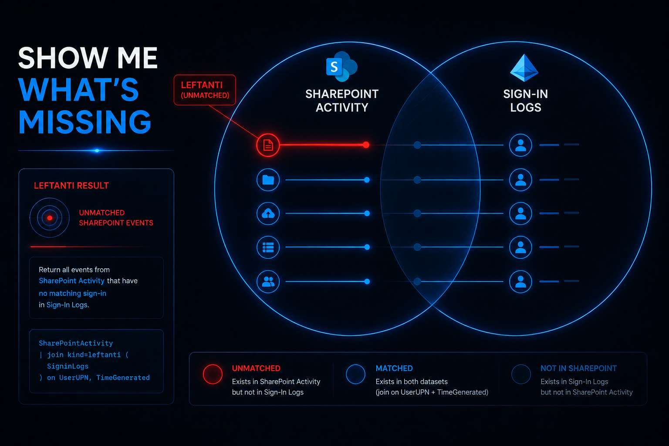
06
KQL Café • Ian Hanley • DevSecOpsDad
Notes:
Teach leftanti. Kusto is doing exactly what you asked: no matching rows on the right with these join keys and this time window. You own the interpretation.

Slide 8
VALIDATE FIRST
07
The field that wasn’t there
Schema availability ≠ telemetry availability.
Validate first. Detect second.
• Is the field populated?
• On which devices?
• By which OS / sensor version?
• Is coverage good enough to support the claim?
KQL Café • Ian Hanley • DevSecOpsDad
Notes:
Documented schema is not the same as populated telemetry. Run population checks before interpreting zero results or claiming coverage.

Slide 9
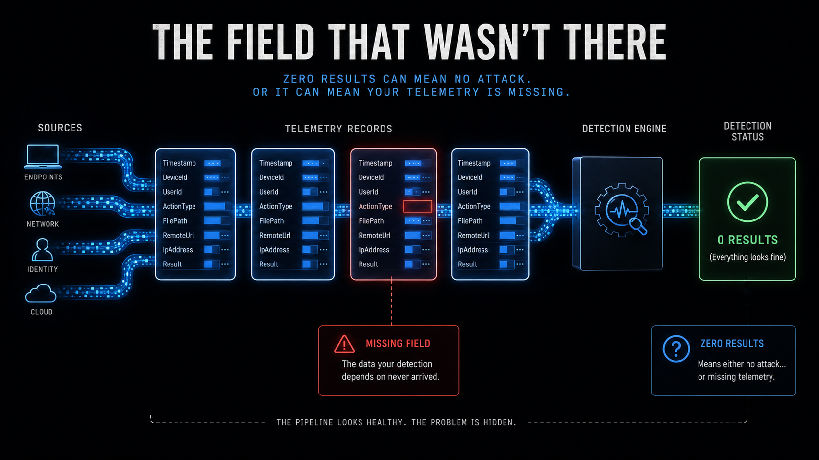
06
KQL Café • Ian Hanley • DevSecOpsDad
Notes:
Teach leftanti. Kusto is doing exactly what you asked: no matching rows on the right with these join keys and this time window. You own the interpretation.

Slide 10
DETECTION DECAY
08
False positives are annoying. False confidence is dangerous.
Noisy detection
Quiet broken detection
Gets investigated
Gets tuned
Creates visible pain
Gets trusted
Claims coverage
Silently decays
A quiet broken detection gets trusted.
KQL Café • Ian Hanley • DevSecOpsDad
Notes:
False positives hurt, but false confidence is dangerous. A 60-day no-fire review is a trigger for revalidation, not a verdict.

Slide 11
WRONG SENSOR
09
A meeting in 2050
Sometimes the telemetry exists — just not where your mental model expected it.
Calendar object
Year: 2050
Attendees: none
→
Attach
Rename
Retrieve
→
Calendar C2
not network C2
ATT&CK is a map. It is not the terrain.
KQL Café • Ian Hanley • DevSecOpsDad
Notes:
Calendar C2 as a fun example. The lesson is not just calendar detections; it is that your mental model controls where you look. Attackers do not care what table you think C2 belongs in.

Slide 12
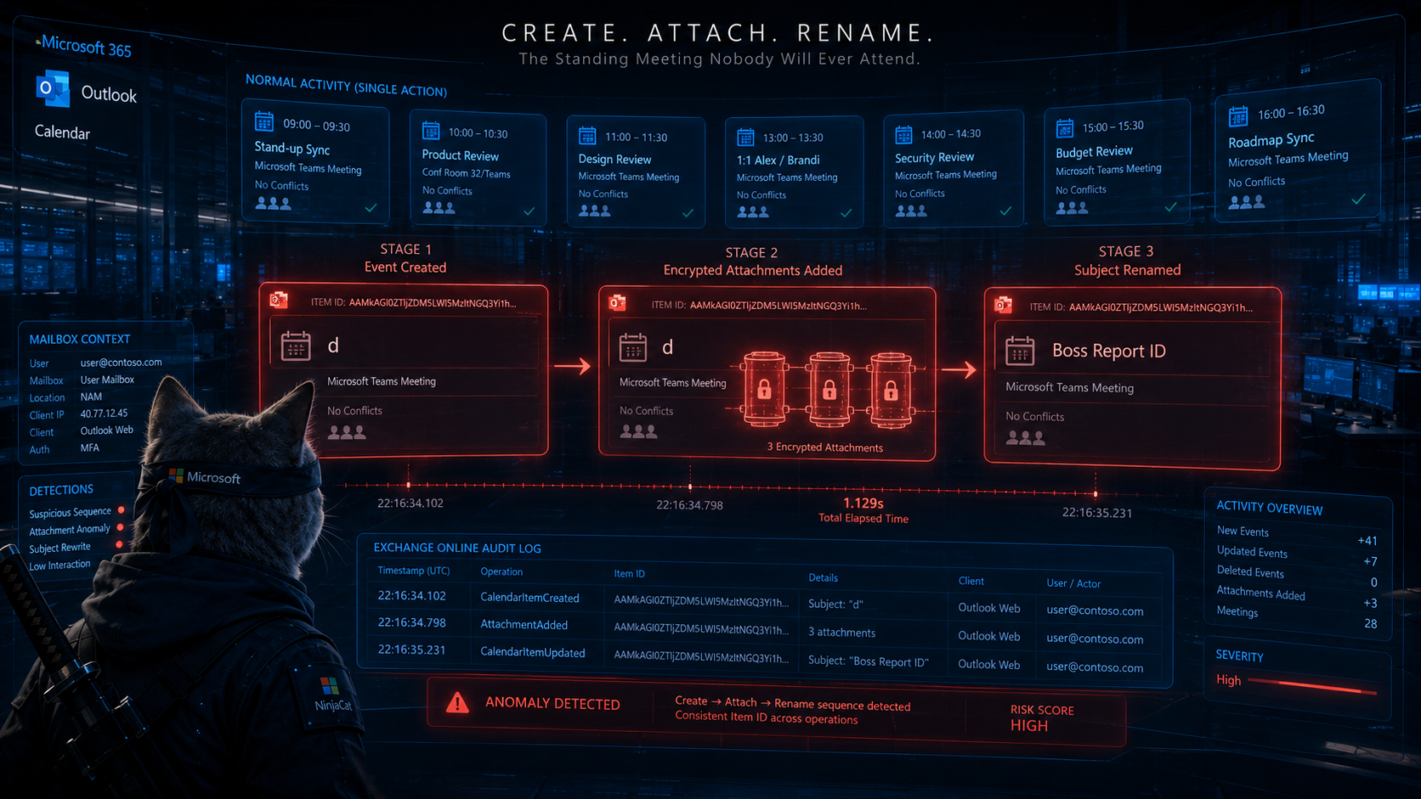
06
KQL Café • Ian Hanley • DevSecOpsDad
Notes:
Teach leftanti. Kusto is doing exactly what you asked: no matching rows on the right with these join keys and this time window. You own the interpretation.

Slide 13
REPRESENTATION
10
The string is not the thing
Detect meaning, not spelling.
169.254.169.254
≠
one spelling
of the destination
Coverage is a claim, not a property.
KQL Café • Ian Hanley • DevSecOpsDad
Notes:
Representation matters: IPs, domains, URLs, paths, hashes, Unicode, casing, and escaping. Detect meaning, not just spelling.

Slide 14
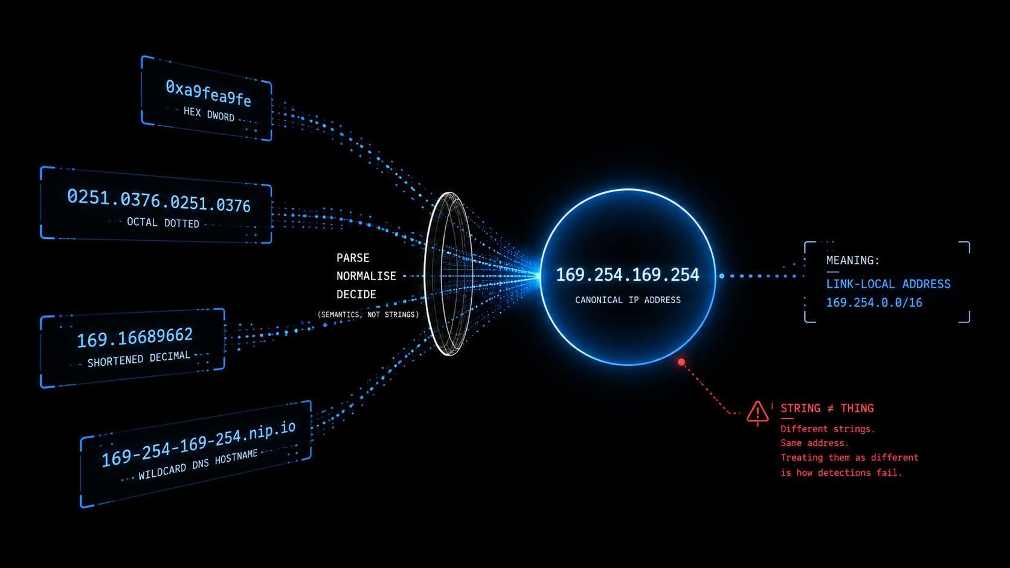
06
KQL Café • Ian Hanley • DevSecOpsDad
Notes:
Teach leftanti. Kusto is doing exactly what you asked: no matching rows on the right with these join keys and this time window. You own the interpretation.

Slide 15
REPRESENTATION
11
The character is not the payload
Unicode tag characters can be signal — but the payload is the decoded meaning.
Representation
→
Meaning
KQL Café • Ian Hanley • DevSecOpsDad
Notes:
Keep this short. The suspicious character is not the whole story; decode and interpret what it represents.

Slide 16
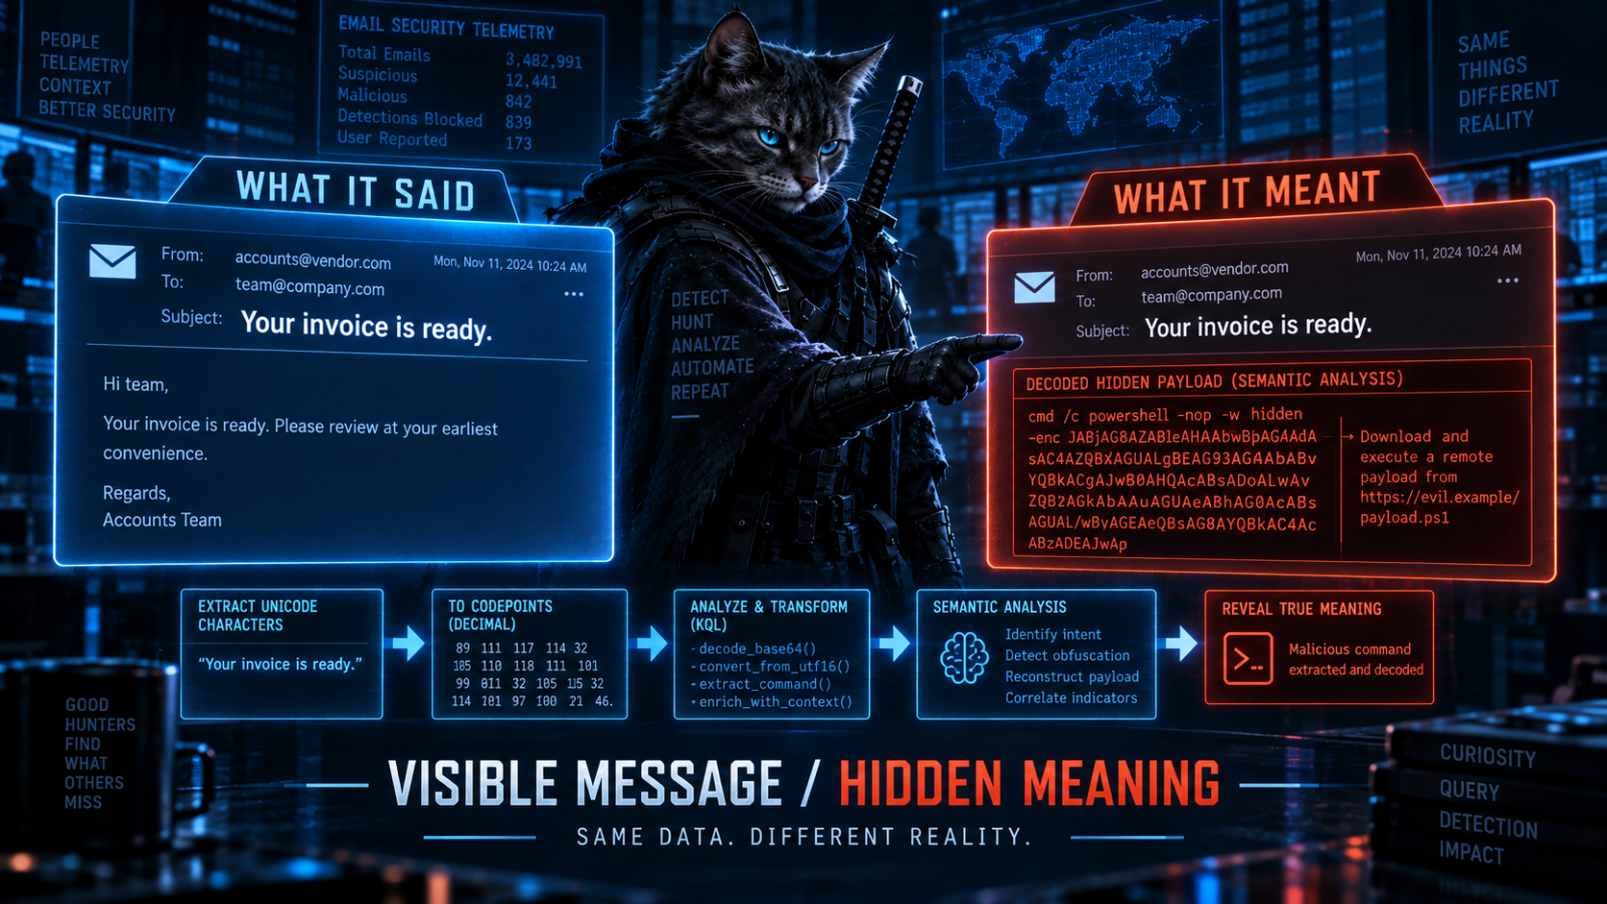
KQL MOMENT: LEFTANTI
06
KQL Café • Ian Hanley • DevSecOpsDad
Notes:
Teach leftanti. Kusto is doing exactly what you asked: no matching rows on the right with these join keys and this time window. You own the interpretation.

Slide 17
KQL MOMENT: PREV()
12
prev() knows rows. You know entities.
Machine A
Machine B
Machine C
fictional sequence
KQL Café • Ian Hanley • DevSecOpsDad
Notes:
prev gives the previous row, not the previous event for the same device/user/process. Serialize is not enough; guard the entity boundary.

Slide 18
KQL MOMENT: JOIN
13
A join is an accusation
Your join key is the evidence.
What relationship does this prove?
• Same identity?
• Same session?
• Same host?
• Same causal chain?
• Same five-minute window?
Temporal proximity is not causality.
KQL Café • Ian Hanley • DevSecOpsDad
Notes:
Kusto will happily join two rows. You are accusing them of being related. Same IP, user, or time window may not be enough.

Slide 19
RELATIONSHIP
14
Parent does not equal lineage
If you care about ancestry, model ancestry.
npm
node
sh
python
curl
The malicious relationship may be several generations away.
KQL Café • Ian Hanley • DevSecOpsDad
Notes:
npm lifecycle example. A parent-child query can miss grandchild behavior. The KQL can compile, the processes can be real, and the analytic can still misunderstand the behavior.

Slide 20
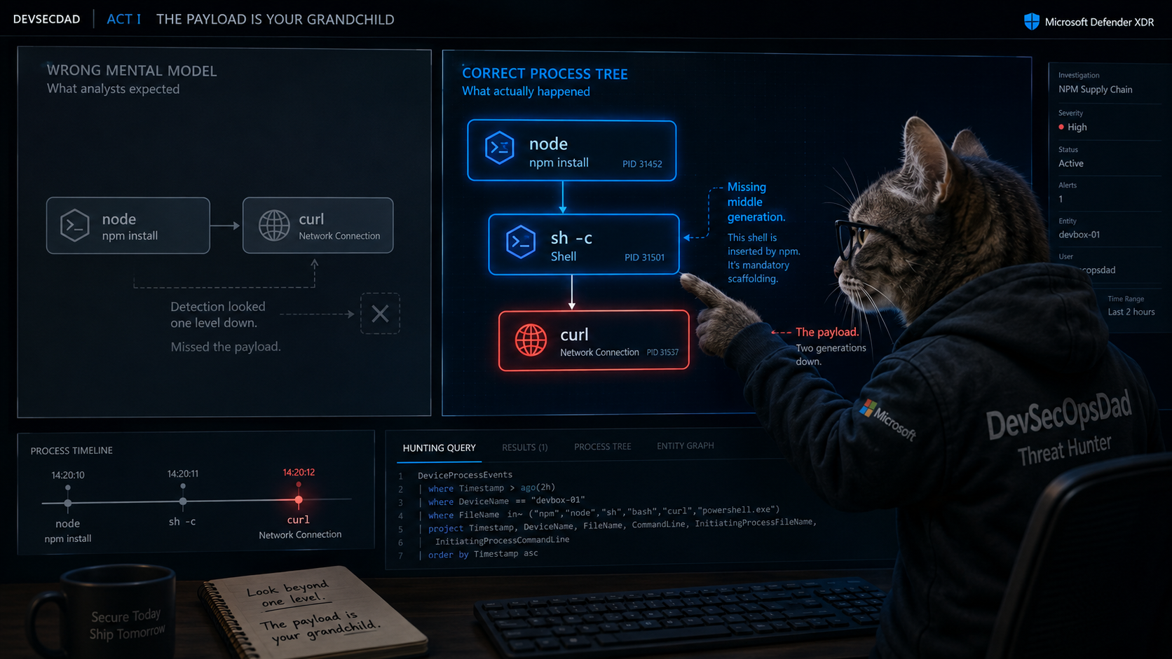
06
KQL Café • Ian Hanley • DevSecOpsDad
Notes:
Teach leftanti. Kusto is doing exactly what you asked: no matching rows on the right with these join keys and this time window. You own the interpretation.

Slide 21
KQL MOMENT: AGGREGATION
15
make_set() is not a timeline
Every summarize is lossy compression.
Membership
≠
Chronology
A query can contain all the right events and still tell the wrong story.
KQL Café • Ian Hanley • DevSecOpsDad
Notes:
make_set gives membership, not chronology. If order matters, establish ordering deliberately. Summarize is often useful but it destroys detail.

Slide 22
TRUST STACK
17
Detection trust is a stack
Claim
Relationship
Identity
Representation
Population
Collection
Observation
The engine cannot save you from a bad premise.
KQL Café • Ian Hanley • DevSecOpsDad
Notes:
Walk up the stack: observation, collection, population, representation, identity, relationship, claim. A perfect query against a bad premise is still wrong.

Slide 23
AI & AUTOMATION
18
Now give the bad premise a GPU
Automation does not remove assumptions. It industrializes them.
Obviously wrong is cheap.
Plausibly wrong is expensive.
Notes:
AI did not invent bad assumptions. It changed scale. The scary outputs are plausible detections that survive casual review.

Slide 24
DEVSECOPSDADATTACK
19
The machine handles scale
The human retains judgment and accountability.
Read
Cluster
Extract
Draft KQL
Critique
Review
KQL Detection of the Week exists because the machine needed a reviewer.
Notes:
Describe the automated pipeline briefly. AI helps read, cluster, draft, and critique. The review process is where assumptions are owned.

Slide 25
HUMAN IN THE LOOP
20
Human-in-the-loop ≠ human rubber stamp
A checkbox is not governance.
• What behavior are we detecting?
• Which telemetry sources are required?
• What fields must be populated?
• What relationships are being inferred?
• What claim is this output making?
Assumption ownership
not ceremonial approval
KQL Café • Ian Hanley • DevSecOpsDad
Notes:
Human in the loop has to mean meaningful skepticism. The human should not redo all AI work, but should own assumptions, edge cases, claims, and consequences.

Slide 26
REVIEW CADENCE
21
AI can challenge. Reality resolves.
Then touch reality:
• Run the query
• Inspect actual telemetry
• Measure field population
• Validate the sensor
• Test the entity boundary
Review is a cadence, not a gate.
KQL Café • Ian Hanley • DevSecOpsDad
Notes:
AI can criticize AI, but the environment resolves factual assumptions. Review should recur when models, prompts, sources, telemetry, or time changes.

Slide 27
REVIEW METHOD
22
Read the detection backwards
Start with the conclusion, then walk toward the sensor.
Claim
Evidence
Relationship
Identity
Representation
Population
Collection
Sensor
The nastiest question:
What would make this return zero even if the attack happened?
KQL Café • Ian Hanley • DevSecOpsDad
Notes:
Practical review method: start with what the detection claims and walk backwards through the trust stack. The key question catches representation, sensor, field, relationship, and chain failures.

Slide 28
TAKEAWAYS
23
Six questions to steal
• Does the telemetry I depend on actually exist?
• Am I detecting the behavior, or one representation of it?
• Are the events I’m correlating actually the same entity?
• What assumptions could silently turn a real attack into zero results?
• What is the cheapest change an attacker could make to evade this?
• What is this system claiming — and who reviewed the evidence?
KQL Café • Ian Hanley • DevSecOpsDad
Notes:
Use this near the close. These apply to human-written KQL, AI-generated detections, automated triage, threat-intelligence summaries, and executive reporting.

Slide 29
The query ran successfully.
That’s the problem.
Use AI. Automate aggressively.
But review the output, review the assumptions, and keep a human accountable for the claim.
Thank you.
Notes:
Close by recapping: leftanti is absence from a right-hand dataset, prev knows rows not entities, make_set is membership not chronology, joins are relationship claims. Automation makes assumption management more important, not less.

